Slide 1
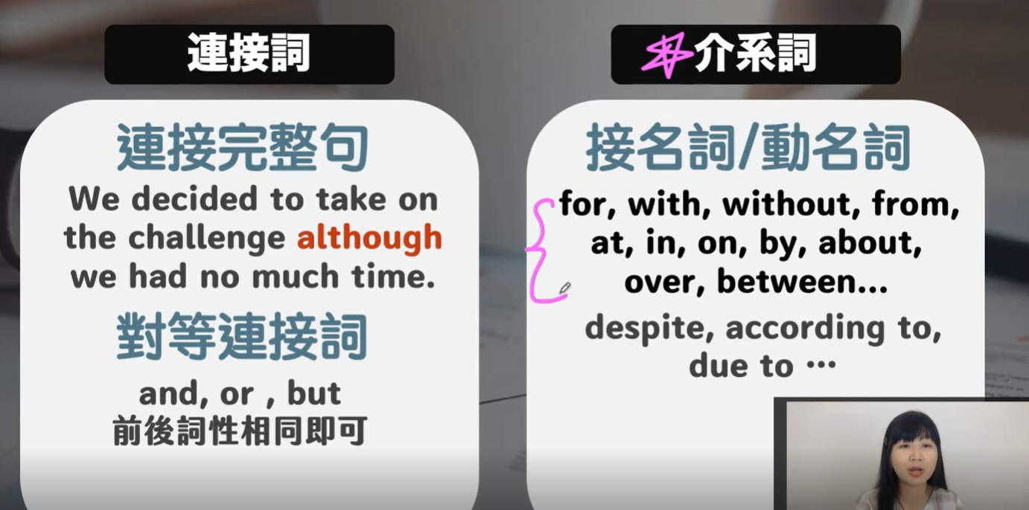

Slide 2


Slide 3


Slide 4
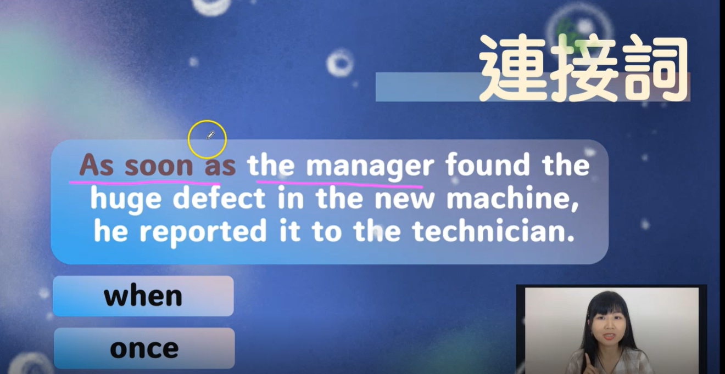

Slide 5
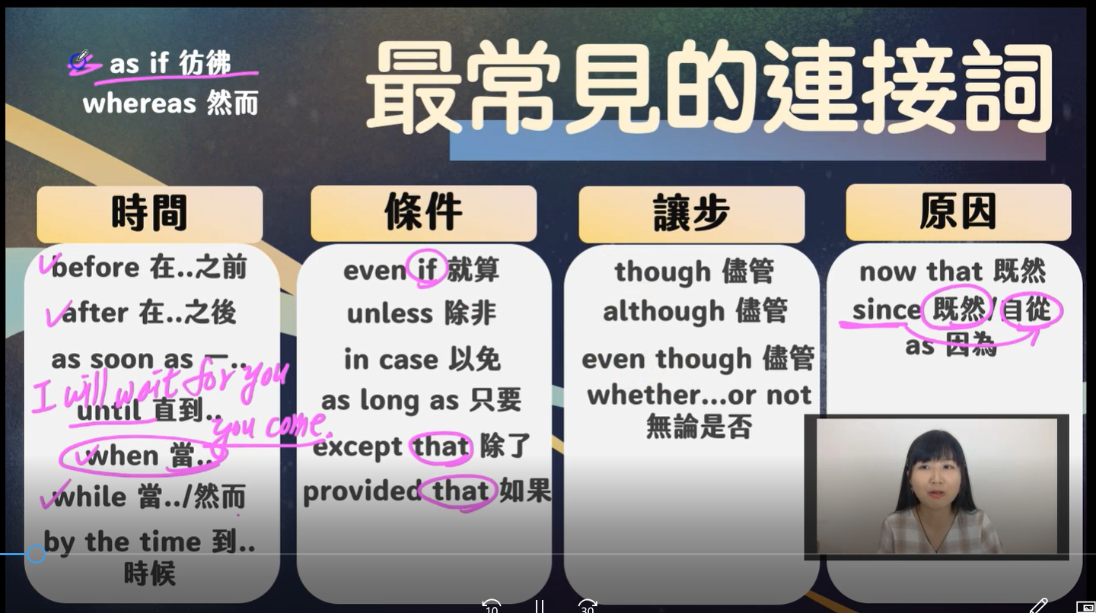

Slide 6


Slide 7
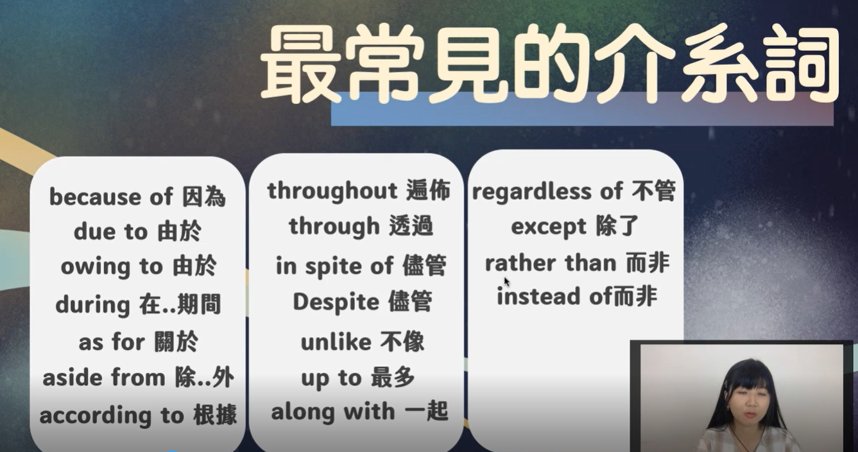

Slide 8
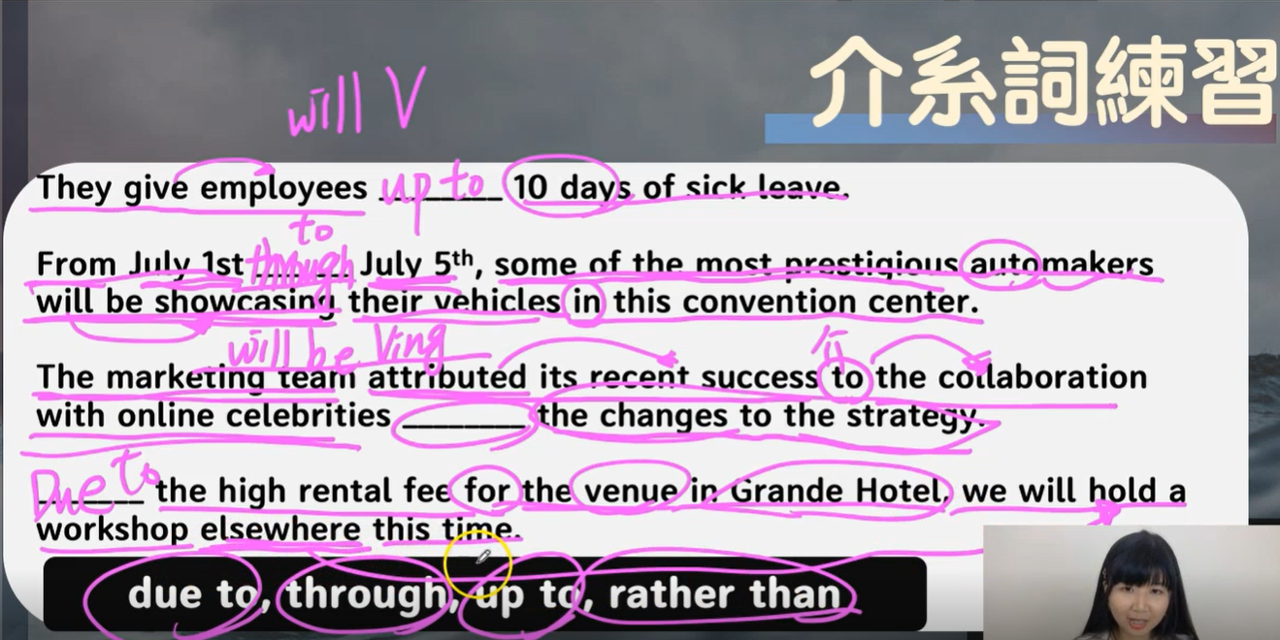

Slide 9


Slide 10
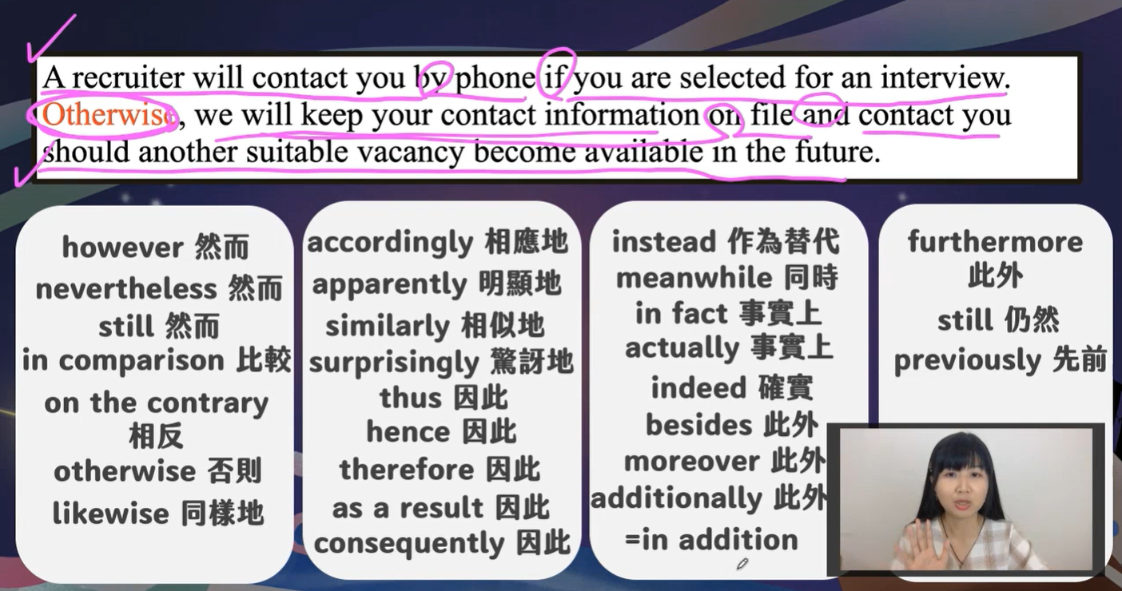

Slide 11
This company spent a huge amount of time researching the
project; _______ ,they didn't attain the desired results.
A. moreover
B. otherwise
C. however
D. therefore

Slide 12


Slide 13
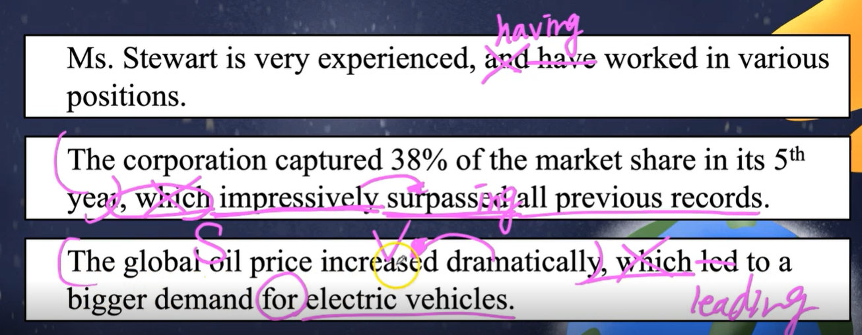
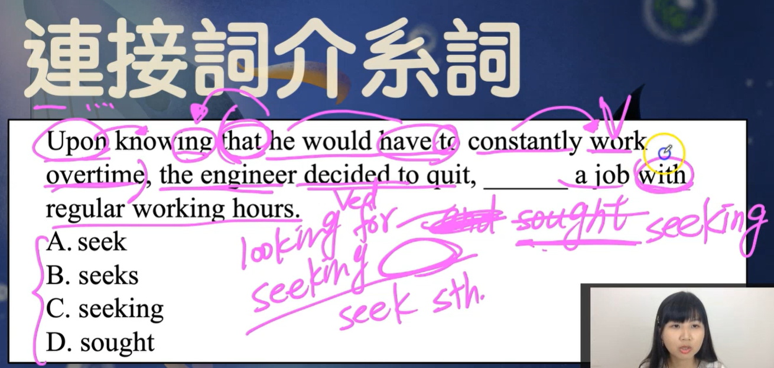

Slide 14
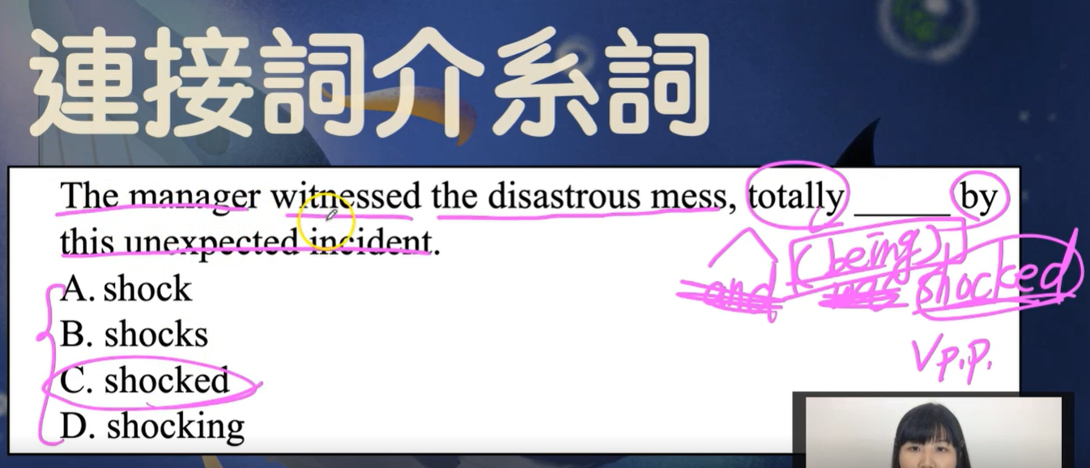
,and totally was shocked (被嚇到 << 被動式)
,being totally shocked
,(being) totally shocked (being 省略)
and 之後要注意動詞是否為被動式

